Slide 1





ICT’21 Batch
Title: Network Traffic Analysis: Enhancing Security and
Performance Insights
Presented By: Hassan Mansuri
Roll No. 21BIT204
Supervised By: Dr. Devlina Adhikari
Ms. Aarti Solanki

Slide 2


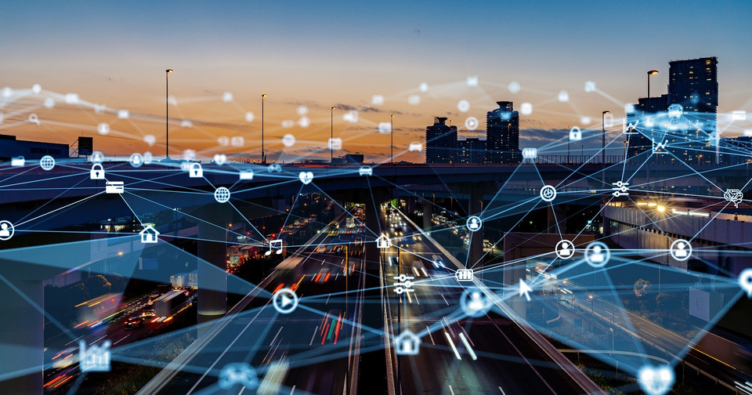
Introduction
=>In today’s interconnected digital world, ensuring network security and performance is crucial.
Challenges Organizations Face:
Detecting security breaches
Identifying performance bottlenecks
Ensuring compliance with regulations
Traditional Tools & Their Limitations (e.g. Logic Monitor):
Manual analysis is time-consuming
Prone to human error
Not feasible for large-scale real-time monitoring

Slide 3
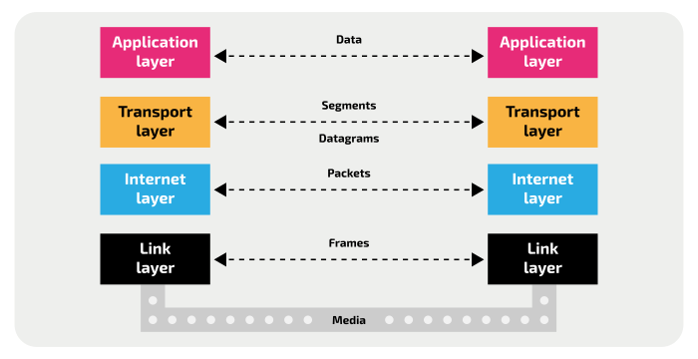


TCP-IP stack for Network Communication
TCP and
UDP

Slide 4
Literature Review
Sr No. | Paper | Year | Topic | Challenges
1. | https://doi.org/10.1109/ICECA58529.2023.10394962 | 2023 | Network Security in Cyberspace | Data Challenges, Model challeneges
2. | https://doi.org/10.1109/GUCON.2018.867497410.1109/NFV-SDN.2016.7919493 | 2022 | Anomaly Detection System using ML | False Positives and Negatives:Finding the right balance between false positives (normal traffic flagged as anomalous) and false negatives (anomalous traffic missed) is crucial.
3. | https://doi.org/10.1109/ICECA58529.2023.10394962 | 2021 | Enabling Efficient Flow Classification using ML | Hardware Limitations:Memory Constraints: Programmable switches have limited memory resources, restricting the complexity of ML models that can be deployed directly on them.

Slide 5
Literature Review Continue
Sr No. | Paper | Year | Topic | Challenges
4. | https://doi.org/10.1109/GUCON.2018.867497 | 2018 | IDS Based Network Security Architecture with TCP/IP | Real-Time Performance: High-volume network traffic demands real-time analysis and response to detect and mitigate attacks promptly.
5. | https://doi.org/10.1109/GUCON.2018.867497410.1109/NFV-SDN.2016.7919493 | 2017 | Network intrusion detection system (NIDS) | SDN-Based NIDS Challenges, the fundamental challenge of SDN-based NIDS is how to handle packet processing flows in an efficient way which is a big chal- lenge to implement NIDS using ML/DL
6. | https://doi.org/10.1109/ICECA58529.2023.10394962 | 2016 | Predicting Network Attack Patterns in SDN | High-Dimensional and Dynamic Data such as feature engineering and data streams

Slide 6
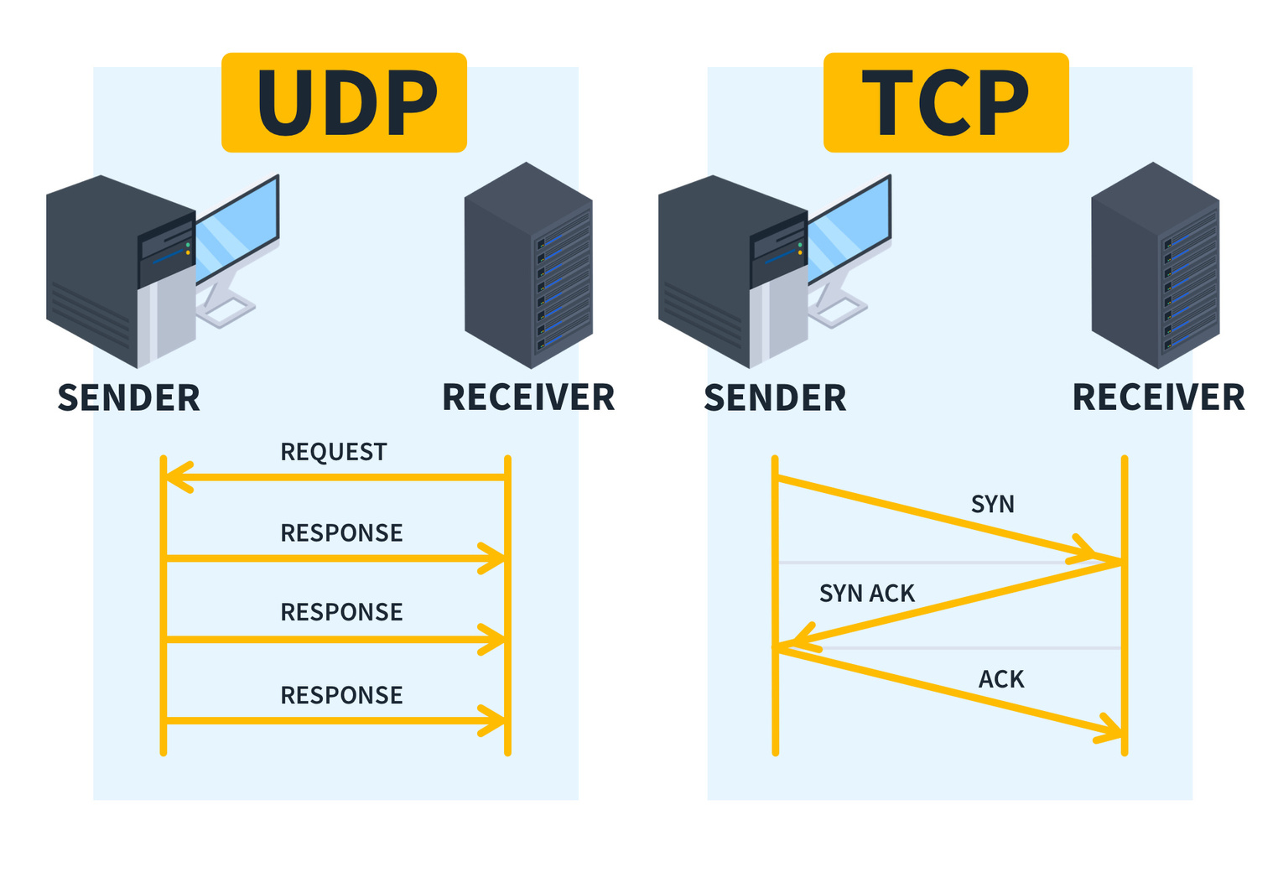
Work Proposal
Transmission Control Protocol (TCP) is a communications standard that enables application programs and computing devices to exchange messages over a network.
=>It is designed to send packets across the internet and ensure the successful delivery of data and messages over networks.

Slide 7
Work Proposal continue...
User Datagram Protocol (UDP) is a network protocol which has applications in real-time multimedia.
=>It's designed to provide a lightweight and low-overhead method for sending datagrams, or chunks of data, across a network.

Slide 8
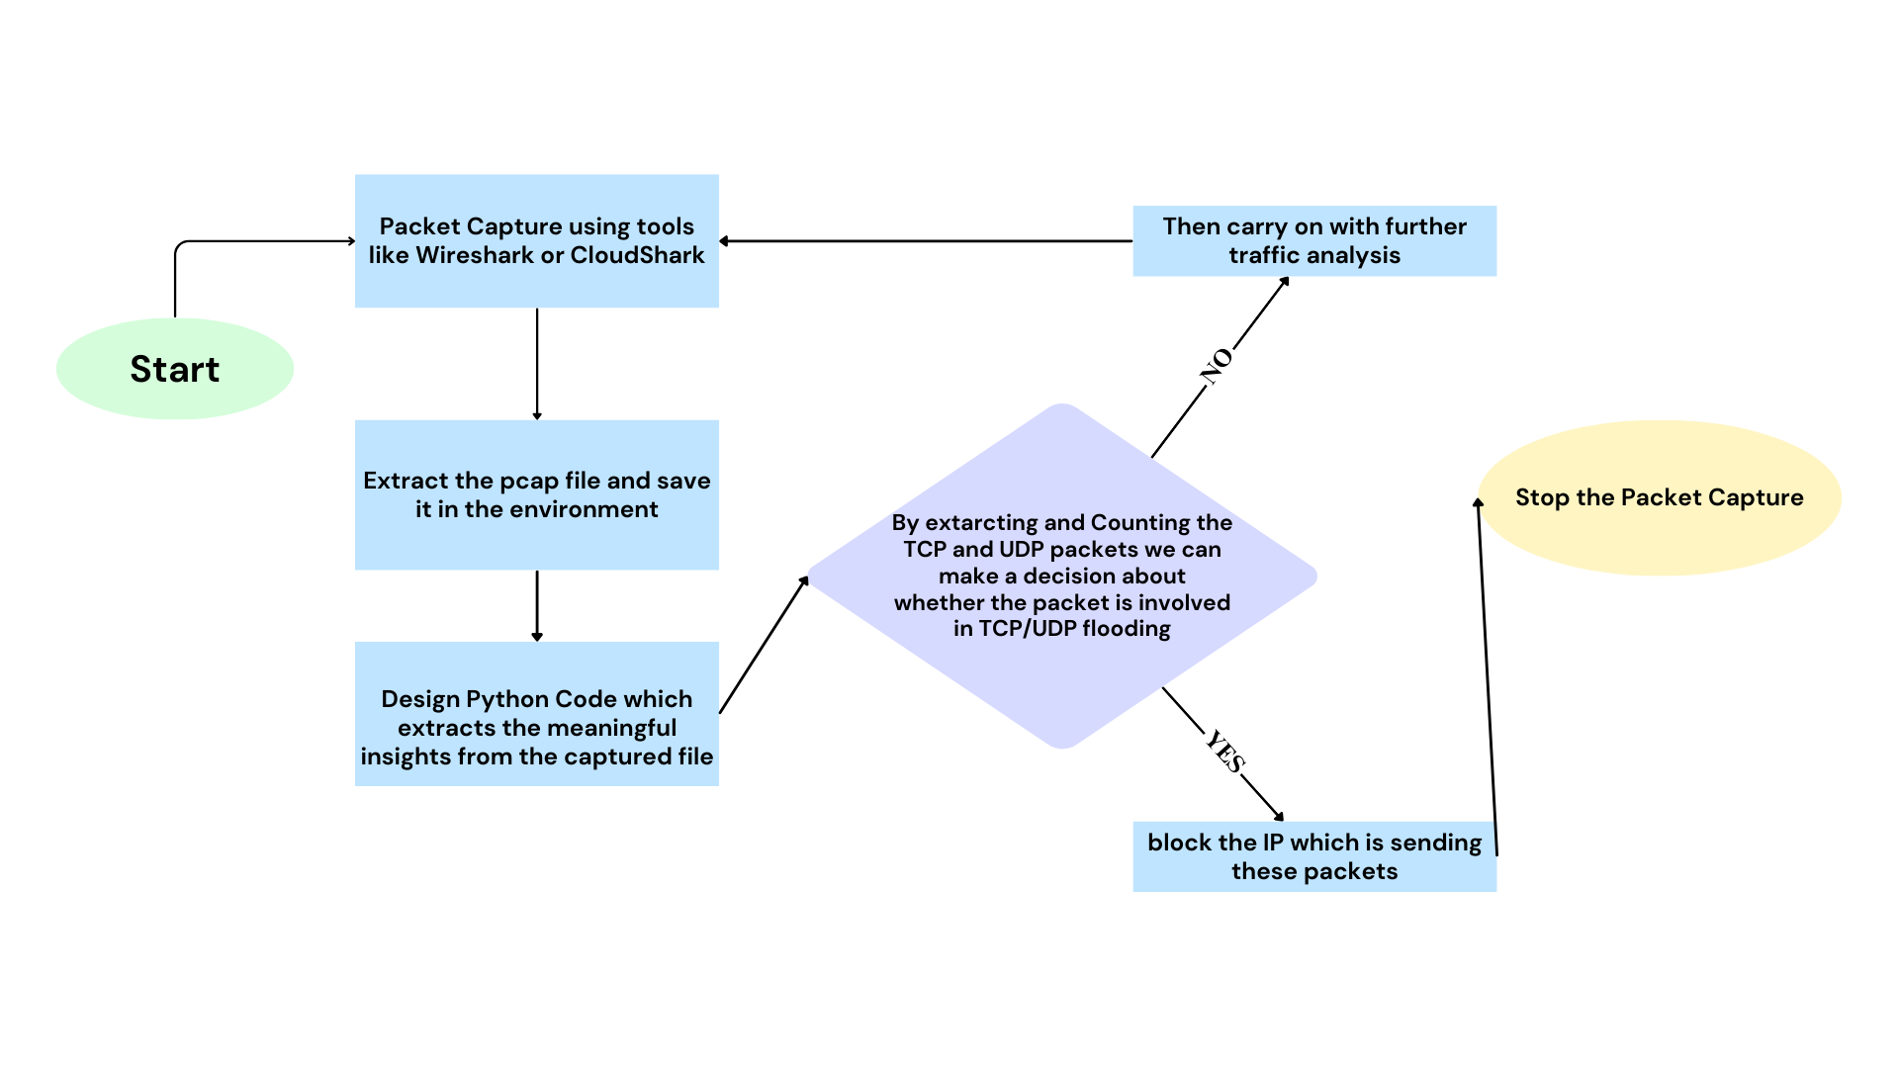
Flow-Diagram for the System

Slide 9
Objectives
Analyze Network Traffic:
Extract essential details such as source and destination IPs, protocols, packet sizes, and bandwidth usage from PCAP files.
Detect Potential DoS Attacks:
Identify unusual traffic patterns, excessive packet flow, or abnormal bandwidth consumption that could indicate a Denial-of-Service (DoS) attack.
Provide Protocol Distribution Insights:
Categorize and analyze network protocols (TCP, UDP) to understand the nature of network traffic.
Identify Port Scanning Activity:
Monitor network packets to detect suspicious port scanning attempts, which are often precursors to cyber attacks.

Slide 10
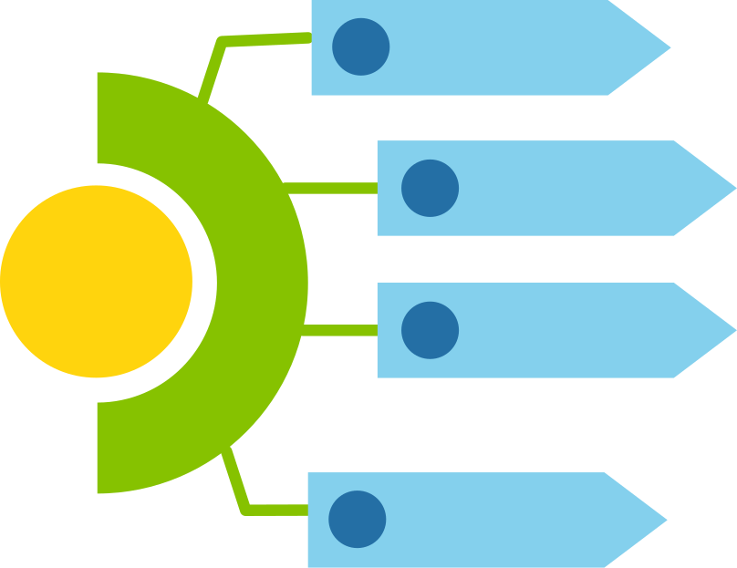
Timeline for work
Week 1-3
Literature review and Topic finalization
Week 4-6
Packet Capturing using Wireshark and extracting meaningful data
Major
Project
Week 7-9
Designing of Python Code and Testing with captured pcap file
Week 10-12
Final Testing, Report writing and Code Review

Slide 11
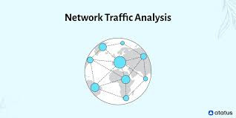
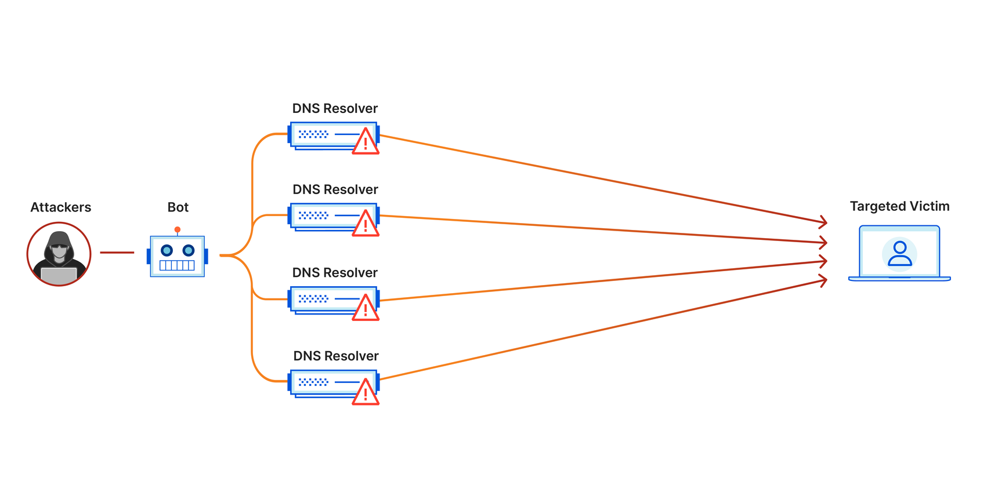
Conclusion
This system will enable network traffic analysis, providing insights into data flow and communication patterns.
It will help detect potential DoS attacks by identifying unusual traffic patterns, excessive bandwidth usage, and port scanning activities.

Slide 12
Thank You

